Slide 1
SCC211 Operation System
(Input and Output)
Zhang Jinyu – zjy@bjtu.edu.cn
School of Computer and Information Technology
SD408

Slide 2
Objectives
Look at I/O mechanisms
How we implement access to devices
Examples based on x86 architecture
Device Drivers
How we encapsulate I/O functions and manage devices within an Operating System

Slide 3
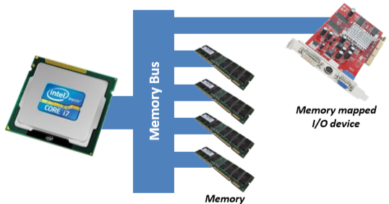
Memory Mapped I/O
考试题
I/O devices visible as normal memory locations
Easily accessed using C pointers
1.将IO看成内存一部分，利用（C语言）指针进行访问
winxp 32 4G
win 7/10 64 8G
数据总线 8根
地址总线 8根

Slide 4
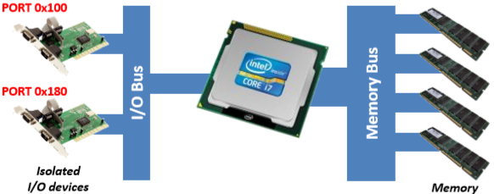
Isolated I/O
2. 独立IO线，专门建一条线共CPU访问
Separate bus for I/O devices
Easier interfacing: distinct from high-speed memory bus
Accessed via special instructions
Generally not supported by compilers (must use assembler)
高级语言只能访问内存

Slide 5
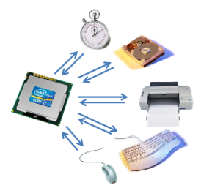
Polling or Busy waiting
轮询：浪费计算机资源
活锁：提高效率，消耗时间
Code ‘spins’ on busy flag* awaiting status change
Very wasteful of processor time
Very difficult to interleave useful code
Need automated mechanism
Also known as Synchronous I/O
自动化机制
轮到谁，就是谁
* Remember: a flag is just a status bit on device e.g. data available, operation complete, …

Slide 6
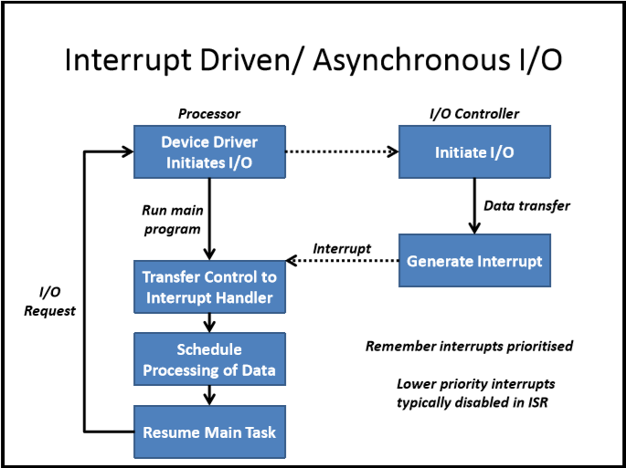
Interrupt Driven/ Asynchronous I/O
解决轮询问题
异步，节省时间
不公平，由于优先级更高而不处理中断
发送数据请求，发送中断请求
cpu相应：处理请求
不响应：等待

Slide 7
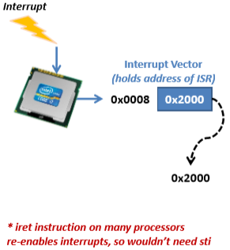
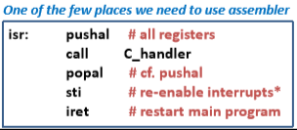
Interrupt Service Routine (ISR)
中断业务历程
必须做
Note we push a copy of all registers so C handler has access to all system state
Some interrupt systems by default
Disable interrupts - typically do
Push all registers - easy but slow
Push few, if any - fast
C :control
不允许其它中断，会把重要信息过滤掉
清空寄存器，留给它用

Slide 8
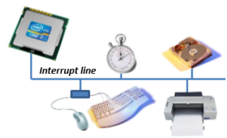
Interrupt
If devices share interrupt/ interrupt line
No idea which generated interrupt
Back to polling
• After interrupt
Must poll each device for data ready/ state change
不知道谁发生中断
轮询每一个设备

Slide 9
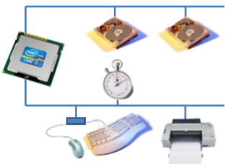
Multiple Interrupt Lines
Narrows search when subsequently polling
Groups similar devices
More support required on processor
Multiple lines/ wires
Multiple ISRs
缩小搜索范围

Slide 10
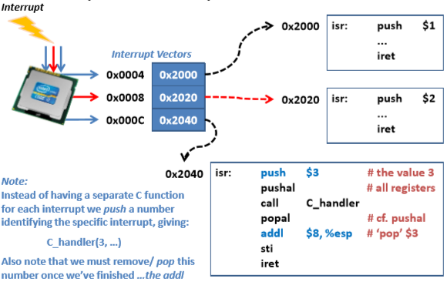
Multiple Interrupt Service Routines
硬盘
时钟
打印
第三个

Slide 11
Pushal Instruction and C Handler
Pushes x86 registers in following order
struct cpu_registers {
uint32_t edi;
uint32_t esi;
uint32_t ebp;
uint32_t esp;
uint32_t ebx;
uint32_t edx;
uint32_t ecx;
uint32_t eax; };
void C_handler( // Interrupt handler called from assembler ISR
struct cpu_registers regs, uint32_t irq,
uint32_t instr_ptr, uint32_t cs, uint32_t cpu_flags ) {
isr: push $3
pushal
call C_handler …
Interrupt number we pushed ($3)
指令寄存器
执行栈
Always pushed by x86 processor

Slide 12
Generalizing the Mechanism
Interrupts
Interrupt Request signal
Generated by device attached to specific wire/ line
Message based
Requested in ‘message’ over intelligent bus, e.g. PCI
Exceptions (can be generic term encompassing others)
Generated in response to internal processor problem
Software Interrupts
Initiated by executing special Interrupt/ Trap instruction
发生中断，电压升高
通过互联网
两种：外部，自己
陷阱，设计好的中断

Slide 13
x86 Exception List
const char * x86Exception[ ] = {
"Division by zero", // 0 F -
"Single step", // 1 FT -
"Non-Maskable Interrupt (NMI)", // 2 I -
"Breakpoint", // 3 T -
"INTO executed with overflow flag set", // 4 T -
"BOUND executed with index outside array bounds", // 5 F -
"Invalid Op-code", // 6 F -
"Device/ Co-processor not available", // 7 F -
"Double fault - no handler for exception", // 8 A 0
"Co-processor Segment overrun (pre i486)", // 9 F -
"Invalid Task State Segment (TSS)", // 10 F E
"Segment not present", // 11 F E "Stack/ Segment Fault", // 12 F E
"General Protection Fault (GPF)", // 13 F E
"Page Fault", // 14 F E
"Exception 0x0F - reserved by Intel", // 15 -
"x87 Floating Point exception", // 16 F
"Alignment check (Ring 3: user mode)", // 17 F 0
"Machine check (internal processor error)", // 18 A ?
"SIMD Floating Point exception", // 19 F -
没有处理
内存管理是分页管理

Slide 14
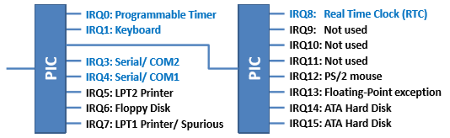
Programmable Interrupt Controller
The PIC is responsible for routing interrupt requests from devices to the appropriate Interrupt Service Routine (ISR) in the system.
软中断
Processor can’t have separate wire to every device
PC now uses Advanced PIC (Intel 82093 APIC)
Gives priority to most important devices
Orders generated interrupts
不能为每一个外设弄一根线
PIC:程序控制器

Slide 15
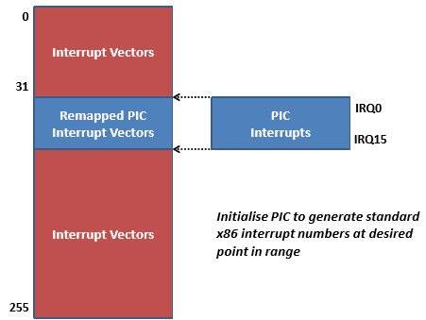
Remapping PIC Interrupts
映射成1个

Slide 16
Precise and Imprecise Exceptions
Precise Exceptions
Current instruction(s) complete execution
Interrupt service routine called
Imprecise Exceptions
Interrupt service routine called
Deeply pipelined instructions not fully complete
Hard to recover from due to unknown state
If unrolled in hardware, leads to complex internal logic
精确的例外
当前指令完成执行
中断服务例程
不精确的例外
中断服务例程
由于未知状态难以恢复．
一级一级执行
没有回滚

Slide 17
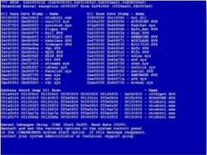
When Exceptions go Wrong
Interrupts MUST be correctly handled
If no interrupt service routine set for interrupt
Processor raises Double Fault interrupt
Unknown state can be hard to recover from
Blue Screen of Death
If double fault isn’t handled
Processor Triple Faults
Causes machine restart
二次中断
出现错误但无法处理

Slide 18
Key feature of Exceptions
Not typically generated by running program*
Though program could be cause
Allows switch from user to system/ kernel mode
As x86 has 4 ring levels, need Requested Privilege Level
Do have software interrupts……
INT/ TRAP instructions
ring 0 系统
ring 1 OS
ring 2 设备驱动
ring 3 用户
// Following set for each Interrupt Vector
// Note x86 records more info than just the ISR address
static void set_IDTentry(struct IDTentry * entry, uint32_t address, uint8_t attributes) {
entry->offset = address;
entry->selector= CODE_SEGMENT(1) | GDT | RPL0;
entry->IDTtype_attr = attributes; }
和身份
身份实体，地址，属性

Slide 19
Clocks and Timers
1s运行千万次
Real Time Clock (RTC)
Returns encoding of current date
Programmable Interrupt Timer (PIT)
Creates periodic event at set/ configurable interval
Used to invoke periodic kernel tasks
If frequency too
Low: Kernel can seem unresponsive
High: OS spends too much time servicing timer
格林威志时间：1970:01:01
周期性
低:内核可能看起来没有响应
高:操作系统花费太多时间维护计时器

Slide 20
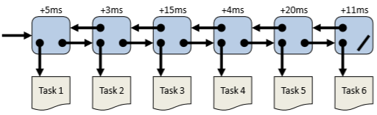
Avoiding Fine-grained Timers
细
Create an event queue: on timer interrupt…
Set interval timer to time delta (+n ms) to next event
Timer fires when next task due, rather than at set period
Technique used widely: OSs, simulators, etc.
我执行完你再执行

Slide 21

Typical I/O Device
Circular buffers help improve data throughput
Help decouple operation of processor and device
Status Register holds flags for
Device ready
Data available, etc.
循环缓冲器有助于提高数据吞吐量，帮助解耦处理器和设备的操作

Slide 22
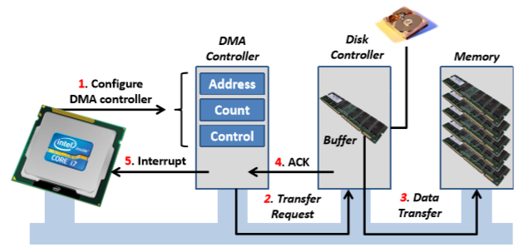
Direct Memory Access
Alternative to programmed I/O
Relieves CPU of data transfer
大量数据从硬盘传到内存
cpu配置DMA
一条一条读
读完后向cpu发送中断说读完了，你可以处理了
有cpu,可运行代码

Slide 23
Managing I/O access within an Operating System
DEVICE DRIVERS

Slide 24
Device Drivers
一致的
Uniform, defined interface to I/O system
Unix adopted a common ‘file oriented’ interface read( ), write( ), ioctl( ), mmap( ), …
Extensible model
Create new drivers as needed
Loadable modules allow run-time changes
Drivers must typically be re-entrant
Can be called again before previous request serviced
考试题
独立IO，IO映射
一开始没有启动，用什么，加载什么
可以重新进入

Slide 25
Unix: Raw Device Entry Points
Entry point | Function
open( ) | Open the device
close( ) | Close the device
ioctl( ) | I/O control operations
mmap( ) | Map device contents into memory
read( ) | Input data
reset( ) | Reinitialise device
select( ) | Poll device for readiness
stop( ) | Stop output on device
write( ) | Output data

Slide 26
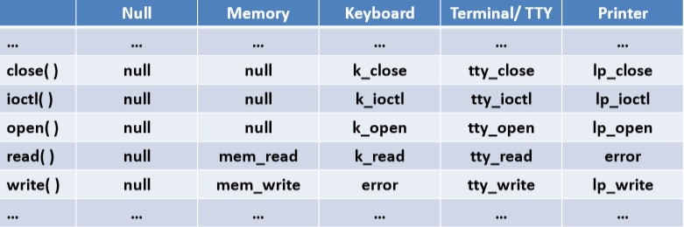
Example device driver functions
Typically maintain table of device functions
Devices have NULL entries for functions/ operations that have no meaning for device
延时，匹配速度

Slide 27
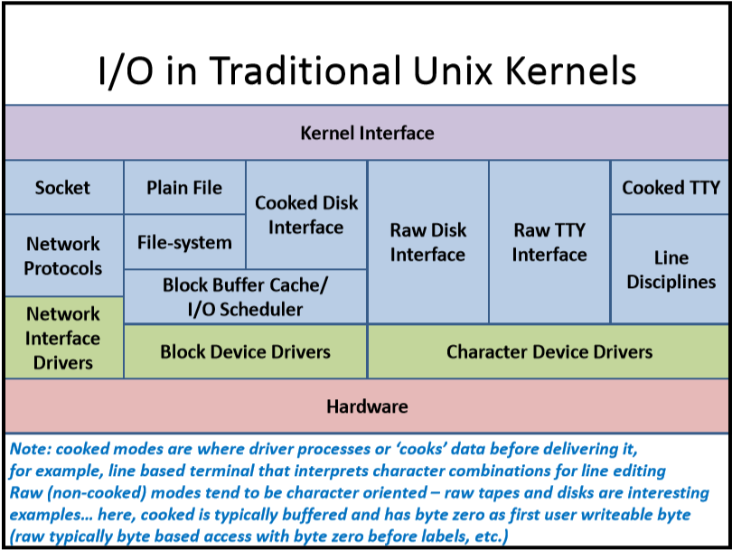
I/O in Traditional Unix Kernels
cache:cpu缓存
cooked:用户端缓存
磁盘
未加密文件
终端放硬盘
硬盘

Slide 28
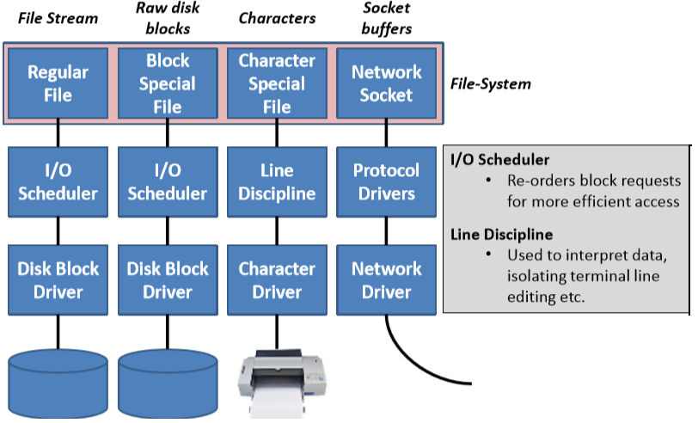
Unix I/O system in use
数据库文件
重新排序，更高效访问
线解释器 八根线
解释数据（00101010->’a’)
硬盘

Slide 29
Device Driver Tasks
考试题
I/O Scheduling
Buffering, Spooling and Caching
Error Handling
I/O Protection
特权，改变顺序
buffer 在内存，一次性处理
脱机服务：将打印文件放进队列一个一个处理
cpu 有缓存
buffer与cache区别？

Slide 30
Single- and Multi-Instance Devices
Single instance (e.g. a printer)
Devices that can only be used by one process
Error if another process attempts to use them
– Often use spool files to sequence requests
Multi-instance
Can handle requests from multiple sources
Create another instance of internal data structures
单个实例(例如打印机)
只能被一个进程使用的设备
错误，如果另一个进程试图使用
它们经常使用spool文件对请求进行序列化
多实例
处理来自多个源的请求,多进程访问
创建内部数据结构的另一个实例

Slide 31
Question？

